Slide 1
One Author, One School
Southbury Elementary School
Community Unit School District #308
Oswego, IL
Notes:
Heather

Slide 2
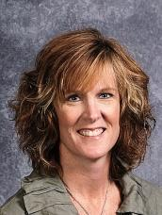
Who Are We?
Heather Kraus
5th Grade Teacher
Masters in Literacy from Judson University

Slide 3
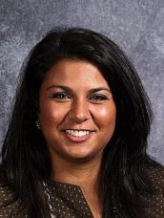
Who Are We?
Noor Shammas
4th Grade Teacher
Masters in Literacy from Judson University

Slide 4
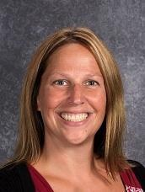
Who Are We?
Lindsay Allen
Principal
Masters in Literacy from Judson University
Current Doctoral Student in Literacy at Judson University

Slide 5
What is OAOS?
Philosophy
School Improvement Goals
Learning Tree
Purpose/Need
Notes:
Heather

Slide 6
Description of OAOS
One Illinois Author
Several Different Titles
Two-Three Week Rotation (K-5)
Variety of Lessons
Assembly/Author Visit
Autographed Book for All
Notes:
Noor

Slide 7
Budget
Raise Money
Title I Funding
IRC Grant
Fundraisers
T-shirts
School Magnets
Little Caesars
School-wide Assembly
Notes:
Lindsay
Thermometer
Pie in the Face
Shave your Head

Slide 8
Getting Started
Vote
Staff and Students
Purchase Books
Create Binders and Schedule Rotation
Summer Promotion
Beginning of the Year Kick-Off
Notes:
Noor
Beginning of the Year Kick-off: Bulletin Board, Marquee, Yellow Book Road, Bookshelf Display

Slide 9
Throughout the Year
Novel Studies
Podcasts
Wax Museum
Bulletin Boards
Writing and Reading Mini-Lessons
Reader’s Theaters
Author Websites
Monthly Book Trailers
Notes:
Heather
For next year: Monthly Book Trailers

Slide 10
Assembly/Author Visit
Planning for Assembly
Contact Author
Grade Level Welcome
Learning Tree Question
Author Liaison/Photographer
Pass Out Autographed Books
Lunch
Classroom Visits
Gift for Author
Notes:
Lindsay
Labels (2-3 months before)
Reference Igniting a Passion

Slide 11
Feedback
End of the Year Staff Survey
Notes:
Noor and Heather

Slide 12
Questions and Comments?
Heather Kraus
hkraus0625@oswego308.org
Noor Shammas
nshammas1211@oswego308.org
Lindsay Allen
lallen@oswego308.org
Notes:
Lindsay

